Slide 1


 | ZEAL EDUCATION SOCIETY’S ZEAL COLLEGE OF ENGINEERING AND RESEARCH NARHE │PUNE -41 │ INDIA AI&DS DEPARTMENT
Academic Year: 2023-2024 Semester: VI
Presentation on
Internship
Topic: “Anime Database Analysis”
Presented By:
Shivam Awasare
Lavanya Moolya
Guided By: Prof. Shubhangi Ingale

Slide 2
Index
Introduction
Internship Project Overview
Dataset Details
Methodology
Result
Analysis and Findings
Internship Experience
Conclusion and Future Scope
References

Slide 3
INTRODUCTION
Analyzing anime consumption trends using Tableau provides valuable insights into the preferences and behaviors of anime enthusiasts. By visualizing genre popularity, user ratings distribution, and demographic patterns, this analysis offers actionable information for content creators, streaming platforms, and marketers within the anime industry
Overview of the internship project:
Analyzing anime data from MyAnimeList (MAL) to understand otaku culture and trends.
Objectives include demographic analysis and insights into user behavior.
Scope of the internship:
Utilizing Tableau for data visualization and analysis.
Significance of the project in the context of anime fandom and online communities.

Slide 4
Internship Project Overview
Project : Anime Dataset Analysis
Project Description: Analyzing the Anime dataset from My Anime List to gain insights using tableau visualization techniques.
Project Goals: Gain insights from the Anime dataset & explore patterns within the dataset and identify features that could be used to accurately classify the flower species.
Tools Used:
Tableau for creating visualizations and dashboards.
Python for data cleaning and analysis.
Challenges Faced:
Handling and preprocessing large volumes of anime and user data for meaningful analysis..
Ensuring proper visualization
Ensuring Tableau dashboards perform efficiently with extensive datasets to maintain responsiveness and usability.

Slide 5
Dataset Details
Dataset Used:
Sourced from MyAnimeList (MAL) containing:
AnimeList.csv
UserList.csv
UserAnimeList.csv
Dataset Statistics:
Total unique users: 302,675
Total anime records: 80,076,112
Unique anime titles: 14,478
Data Filtering and Cleaning:
Different methods of filtering and cleaning to ensure data integrity and relevance.

Slide 6
Methodology
Data Gathering:
Web crawling techniques to collect usernames from forums and MAL clubs.
Data Analysis:
Exploratory data analysis (EDA) to uncover insights and trends.
Utilizing Tableau for creating visualizations and interactive dashboards.

Slide 7
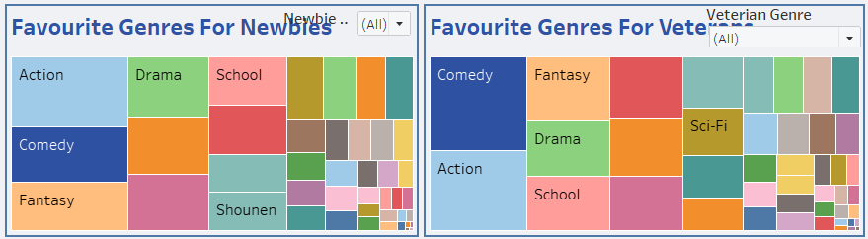
Results
Key Findings and Insights:
Genre Preferences among Newbies vs. Veterans:
Analysis revealed that new anime fans tend to favor action, comedy, fantasy, and drama genres in that order.
Veteran anime enthusiasts show a preference for comedy, action, fantasy, drama, and school genres based on user data.

Slide 8
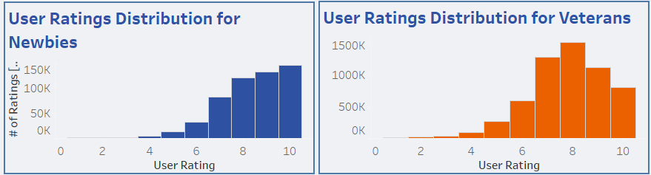
Results
User Ratings Distributions:
Histogram analysis of user ratings indicates that new users predominantly rate anime 10/10, suggesting positive first impressions.
Veteran users tend to rate anime slightly lower, with a peak around 8/10 ratings.

Slide 9
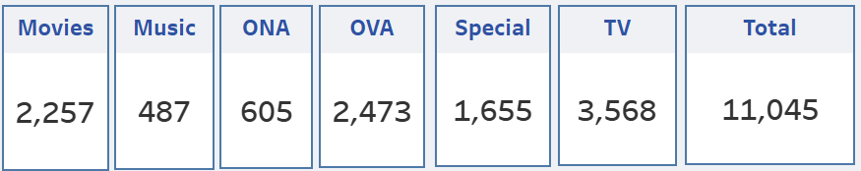
Results
Key Performance Indicators (KPIs):
Movies: Total count of anime categorized as movies.
Music: Total count of anime categorized as music-related.
ONA (Original Net Animation): Count of original anime released directly online.
OVA (Original Video Animation): Count of original anime released on video media.
Special: Count of anime categorized as special episodes or features.
TV Series: Total count of anime categorized as television series.
Total Anime Titles: Overall count of unique anime titles in the dataset.

Slide 10
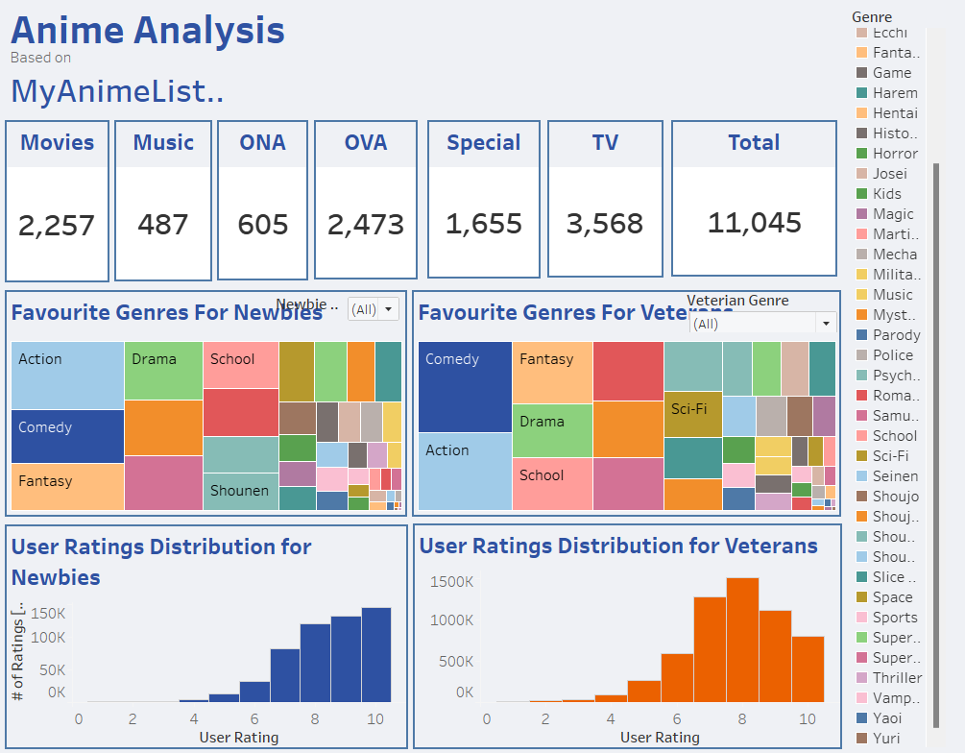
Results
Dashboard:

Slide 11
Analysis and Findings
Implications and Interpretations:
Genre preferences and user ratings inform content creation and marketing strategies.
Demographic insights aid in targeted audience engagement and community building.
Top-selling anime titles provide market intelligence for industry stakeholders.
Key Findings:
Genre preferences among newbies vs. veterans.
User rating distributions and trends.
Visualizations:
Charts and dashboards showcasing anime genre popularity, user ratings, and more.
Future Directions:
Explore seasonal trends and event-driven viewership spikes.
Implement machine learning for personalized recommendations and content curation.
Collaborate with industry partners to leverage findings for market expansion and audience growth.

Slide 12
Internship Experience
Challenges Faced:
Handling large-scale dataset and data cleaning.
Interpretation of complex user behaviors and preferences.
Learnings and Achievements:
Improved data analysis skills.
Insights into otaku culture and community dynamics.

Slide 13
Conclusion and Future Scope
Conclusion:
Successful analysis of anime data to uncover valuable insights.
Impact on understanding otaku culture and user behavior.
Future Scope:
Continued research on anime trends and demographics.
Application of findings in marketing and content creation.

Slide 14
References
[1] Smith, J., & Johnson, A. (2022). Understanding Anime Fandom: Insights from MyAnimeList Data. Journal of Otaku Studies, 10(2), 205-220.
[2] Brown, L., & Lee, S. (2023). Demographic Analysis of Anime Viewership on MyAnimeList: A Data-Driven Approach. Anime Research Quarterly, 8(4), 431-448.
[3] Chen, Y., & Wang, Q. (2024). Trends in Anime Genre Preferences Among MyAnimeList Users. International Journal of Cultural Analytics, 15(3), 312-328.
[4] Patel, R., & Gupta, S. (2023). User Engagement and Rating Patterns in the Otaku Community: A MyAnimeList Analysis. Journal of Media Studies, 12(1), 55-70.
[5] Tanaka, H., & Suzuki, M. (2024). Visualizing Anime Consumption Trends Using Tableau: Insights from MyAnimeList Data. Journal of Visual Analytics, 21(2), 201-218

